Slide 1


Arduino Programming with Visual Studio 2015
Matthew Heironimus
St. Louis Days of .NET 2015

Slide 2





































Platinum Sponsors
Gold Sponsors
Silver Sponsors

Slide 3






Maker Movement
instructables
Notes:
How many of you spent hours playing Tinker Toys, Erector Sets, or Legos growing up? How many of you still spend hours playing with these toys? These toys inspired us to be makers instead of consumers.
The maker movement is the umbrella term for independent inventors, designers, and tinkerers. A convergence of computer hackers and traditional artisans. The movement has become big enough to have its own magazine, conferences or Maker Faires, and even hackerspaces where makers share time and resources to work on each other’s projects.
There are actually many aspects to the Maker Movement, but the aspect I am going to talk about today is hardware and software.

Slide 4
Internet of Things (IoT)
Network of physical objects (i.e. things)
Embedded with
Electronics
Software
Sensors
Network Connectivity
Collect and exchange data via the Internet
Data Analytics
Notes:
Along with the “Maker Movement” there has a been a lot of interest in what is being called the “Internet of Things”.

Slide 5
Internet of Things (IoT)
Gartner 2020 Predictions
7.3 Billion Mobile Devices (phones & tablets)
26 Billion IoT Devices
Reference: http://www.gartner.com/newsroom/id/2636073

Slide 6

Major Hardware Platforms
Raspberry PI
Arduino
Notes:
The two big players in this space are Raspberry PI and Arduino. Yes, there are others, like the Intel® Edison, but Raspberry PI and Arduino are the two biggest players.

Slide 7
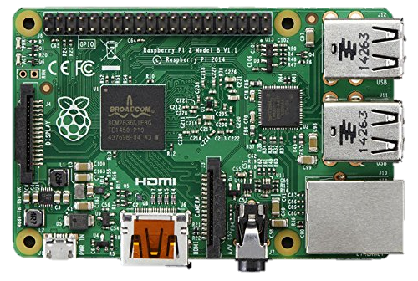
Raspberry PI
Raspberry Pi 2 Model B
900MHz quad-core ARM Cortex-A7 CPU
1GB RAM
Micro SD card slot

Slide 8
Raspberry PI
System-On-a-Chip (SoC)
Operating System
Linux
Windows 10 IoT Core
Ethernet & USB
HDMI Video
GPIO pins (General-Purpose Input/Output)
USB Keyboard & Mouse

Slide 9
Raspberry PI
Projects the Raspberry PI is Good For
Home Theater PC / Streaming Media Center
Arcade Machine Emulator
Classic Console Game Emulator
Web Server
Internet Radio

Slide 10
Arduino
Arduino is an open-source prototyping platform based on easy-to-use hardware and software.
Inexpensive
Cross-platform (Windows, Linux, Mac OSX)
Open source and extensible software
Open source and extensible hardware

Slide 11
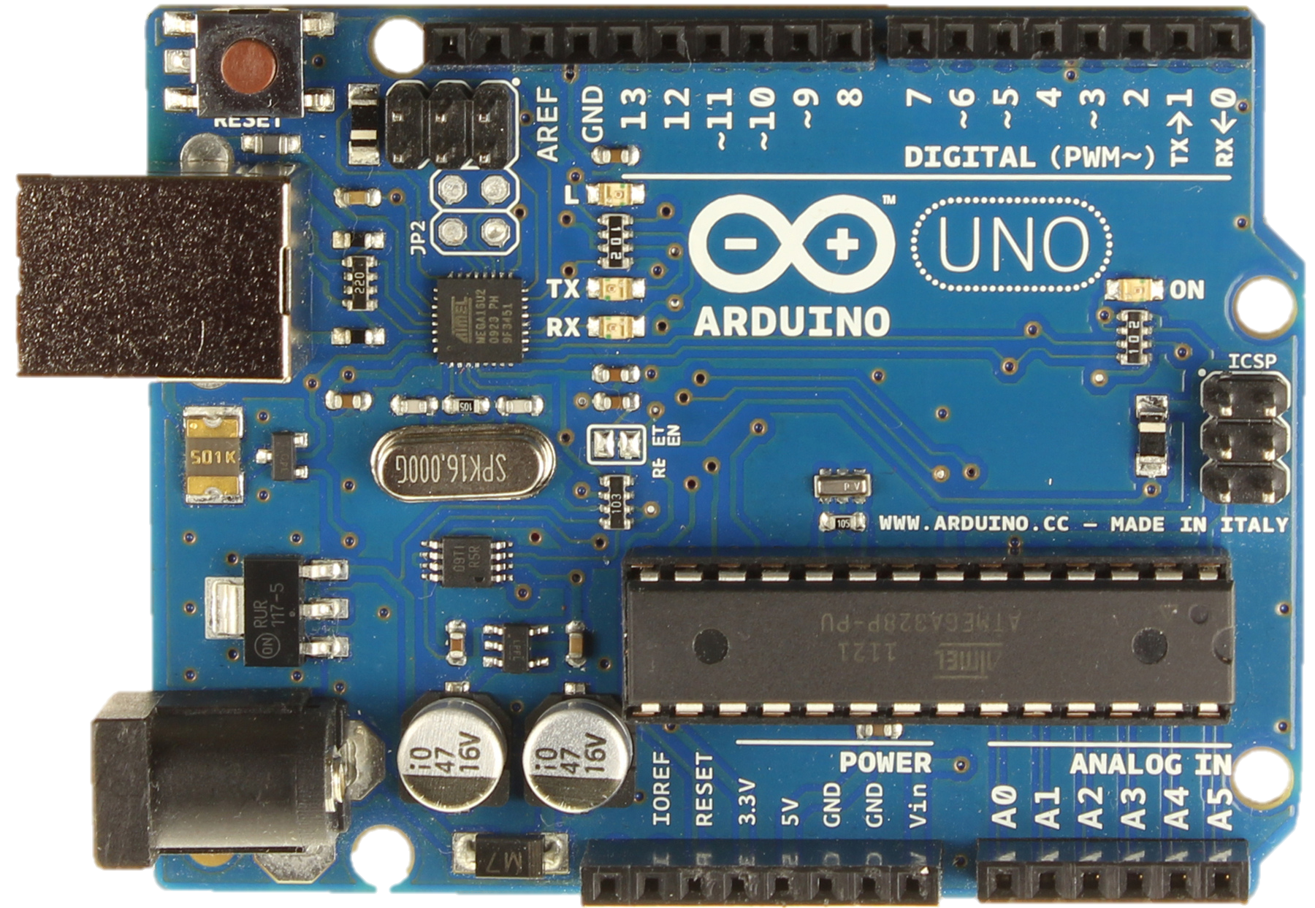
Arduino
Arduino UNO
16 MHz 8-Bit ATmega328P Microcontroller
2 KB RAM
32 KB Flash Memory
14 Digital I/O Pins
6 Analog Pins
USB - Atmega16U2

Slide 12
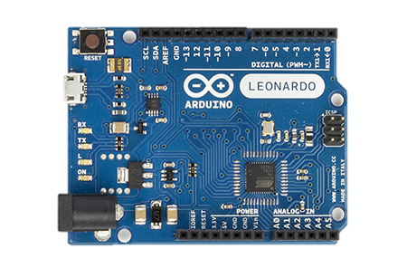
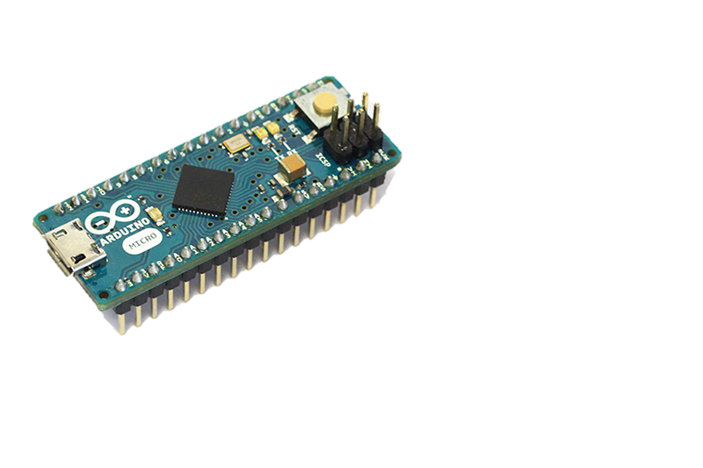
Arduino
Arduino Leonardo & Micro
16 MHz 8-Bit ATmega32U4 Microcontroller
2.5 KB RAM
32 KB Flash Memory
14 Digital I/O Pins
6 Analog Pins

Slide 13
Arduino
Projects Arduino is Good For
Simple Robots
Home Automation
Input Devices
Joysticks, Keyboards, Mice, etc.
PC to Hardware Interfaces
IoT Projects

Slide 14
Demonstration
Notes:
Demonstrate the PC to Hardware demo.

Slide 15
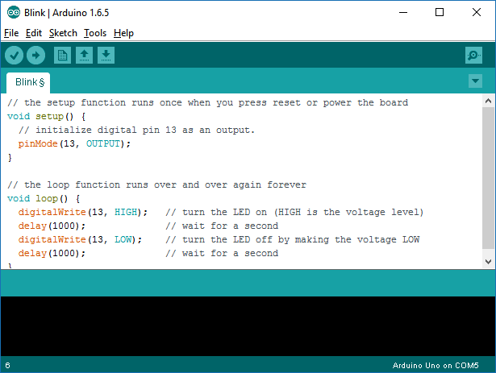
Arduino
Arduino’s Biggest Shortcoming
Notes:
Is its IDE

Slide 16
Arduino
Arduino Integrated Development Environment Features
Cut/Copy/Paste
Search & Replace
Color Syntax Editor
Increase/Decrease Indent
Comment/Uncomment Code

Slide 17
Visual Studio 2015
Visual Studio Features I Miss
Intellisense
Search & Replace with Regular Expression Support
Column Select
Spellchecking (with extension)
Code Snippets

Slide 18
Visual Studio 2015
can be used to program the

Slide 19
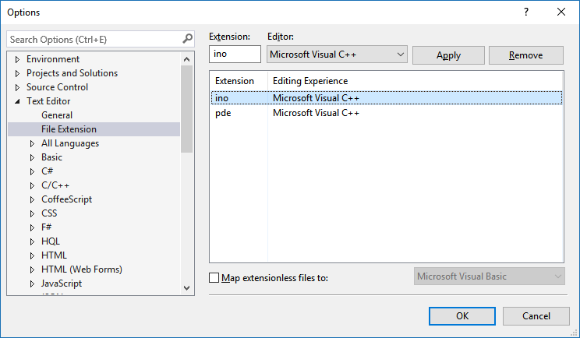
Visual Studio 2015
Arduino Sketch Files (*.ino) are C++ files
For more details see http://playground.arduino.cc/Code/VisualStudio

Slide 20

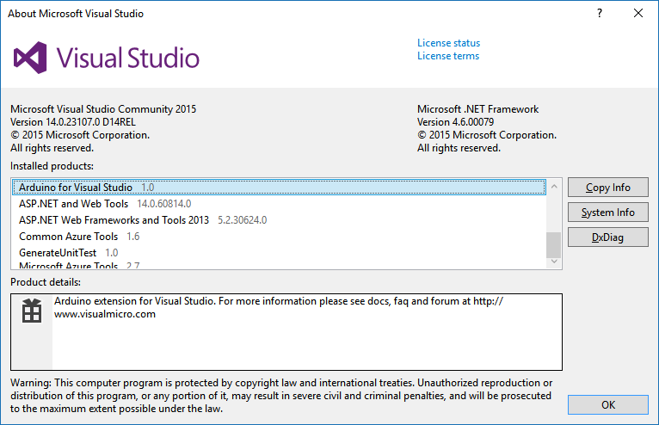
Visual Micro

Slide 21
Visual Micro
Arduino IDE for Visual Studio / Visual Micro
Made by Visual Micro
Extension for Microsoft Visual Studio 2008-2015
Two Editions
Visual Micro (free)
Visual Micro Pro
Hobby: £15.00 (~ $24)
Commercial: £49.00 (~ $85)

Slide 22
Visual Micro
Standard Visual Studio IDE Features
Search & Replace with Regular Expression Support
Column Select
Etc.
Visual Micro Explorer (Arduino Documentation)
Jump to code definition
Jump to compiler error
Class explorer
Intellisense
Code completion

Slide 23

Installing Visual Micro
Arduino IDE
Version 1.6.5
Download at: https://www.arduino.cc/en/Main/Software
Notes:
Must have the Arduino IDE installed.

Slide 24
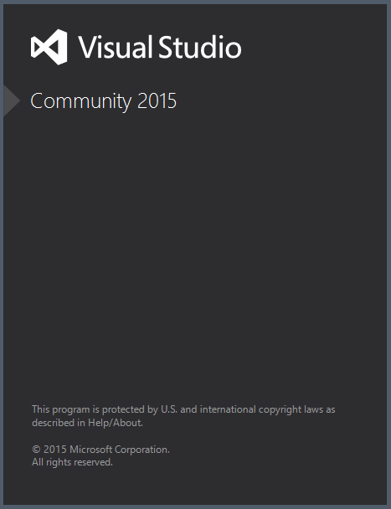
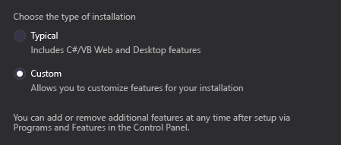
Installing Visual Micro
Visual Studio
Community 2015
Include Visual C++
Note: In 2015, Visual C++ is not installed by default.
Download at: https://www.visualstudio.com/products/

Slide 25
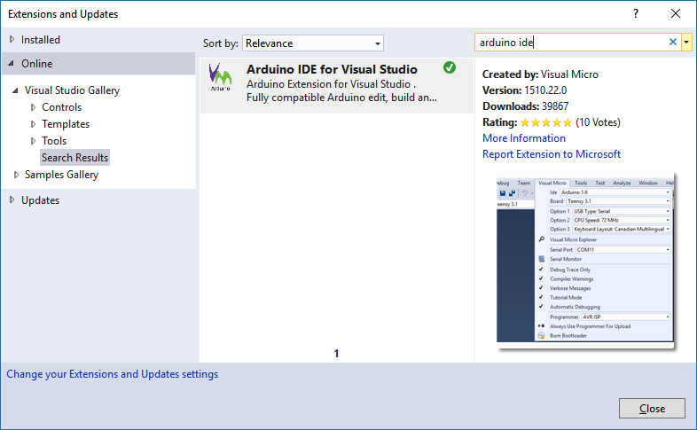
Installing Visual Micro

Slide 26
Demonstration
Visual Micro
Notes:
Simple Blink (a.k.a. Hello World) application
// the setup function runs once when you press reset or power the board
void setup() {
// initialize digital pin 13 as an output.
pinMode(A0, OUTPUT);
}
// the loop function runs over and over again forever
void loop() {
digitalWrite(A0, HIGH); // turn the LED on (HIGH is the voltage level)
delay(1000); // wait for a second
digitalWrite(A0, LOW); // turn the LED off by making the voltage LOW
delay(1000); // wait for a second
}
Load up the more complex “Blink without Delay” example and modify to work with our setup.
Be sure to demonstrate:
Intellisense
Code completion
Go to Definition (extract out a function from the main loop)
Documentation

Slide 27
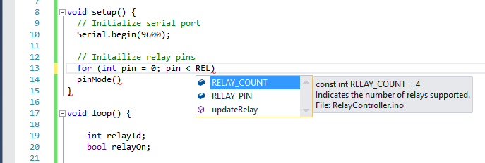
Visual Micro
Intellisense
Code completion

Slide 28
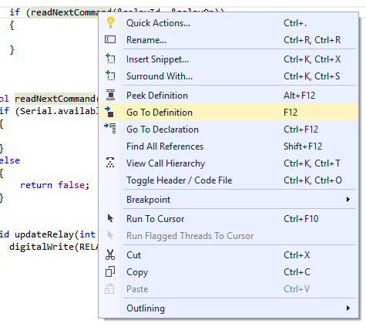
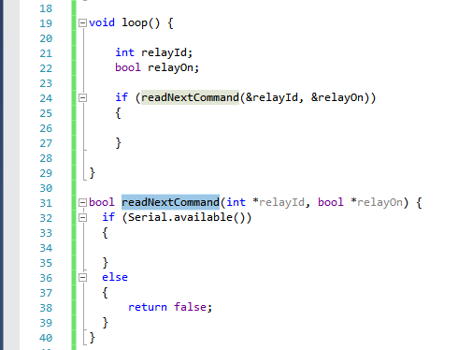
Visual Micro
Go to Definition

Slide 29
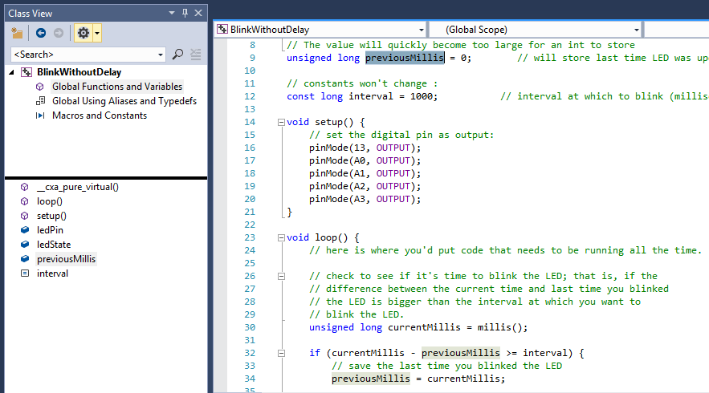
Visual Micro
Class View

Slide 30
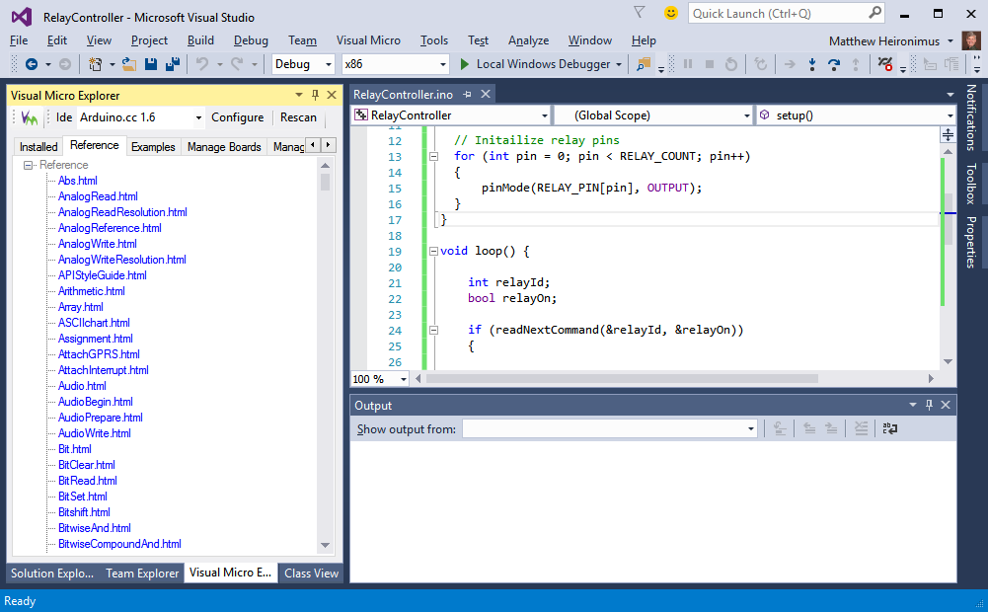
Visual Micro
Documentation

Slide 31
Visual Micro Pro
Debugging
£15.00 (~ $24)
Breakpoints
Conditional Breakpoints
Breakpoints with Counters
Enabling/Disabling Breakpoints
Watch Window
Change Variable’s Value
Notes:
Reference: http://www.visualmicro.com/page/User-Guide.aspx?doc=Debugging-Explained.html

Slide 32
Demonstration
Visual Micro Pro
Notes:
Using BlinkWithoutDelay.ino:
Breakpoint
Breakpoint with a Condition
Breakpoint with an Action
Breakpoint with an updatable variable

Slide 33
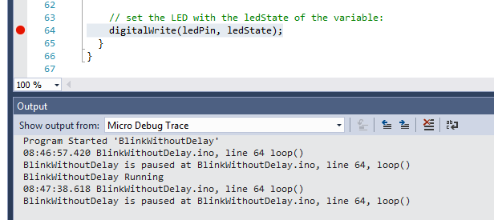
Visual Micro
Breakpoint

Slide 34
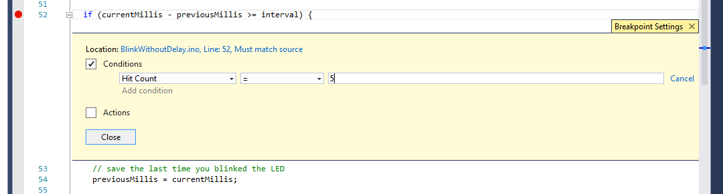
Visual Micro
Breakpoint with Condition

Slide 35
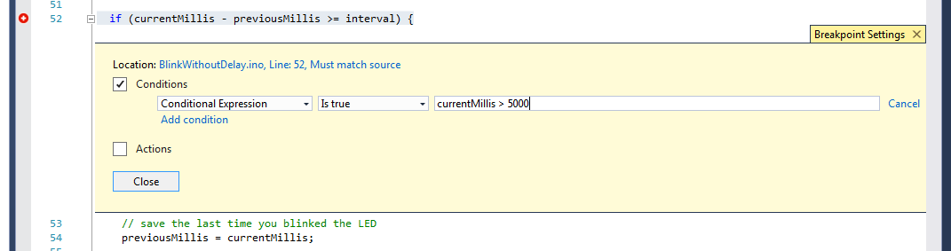
Visual Micro
Breakpoint with Condition

Slide 36
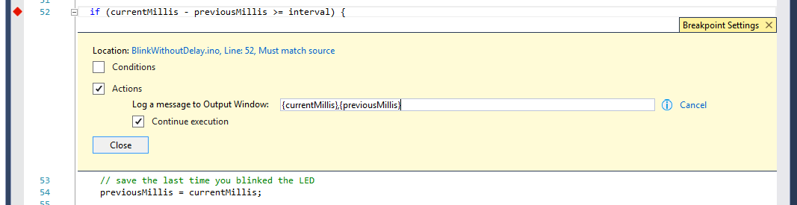
Visual Micro
Breakpoint with Action

Slide 37
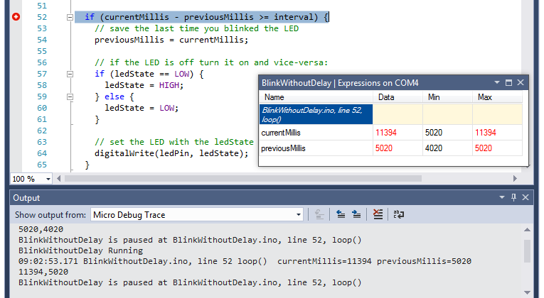
Visual Micro
Breakpoint with Action

Slide 38
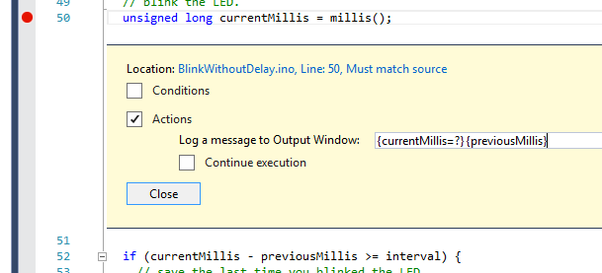
Visual Micro
Changing Variable’s Value
Add =? to the end of the variable name

Slide 39
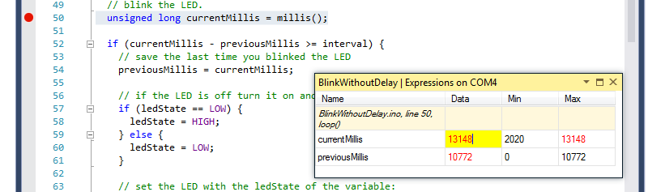
Visual Micro
Changing Variable’s Value

Slide 40
Visual Micro Pro
Debugger is pretty limited
Breakpoints must be set before compiling and uploading sketch
Breakpoint expressions are not validated until compile-time
Execution stops after the line the breakpoint is on has executed (not before like most debuggers)

Slide 41


Getting Started with Arduino
Arduino Website - http://arduino.cc/
Where to buy?
Brentwood, MO @ I-170 & I-64
Gateway Electronics 2220 Welsch Industrial Court St. Louis, MO
http://makershed.com/

Slide 42
Downloads
All example Arduino sketch files and the source for the example Windows application can be downloaded at http://bit.ly/STLDODN2015.

Slide 43

June 2012
Massimo Banzi, Arduino co-founder
http://www.ted.com/talks/massimo_banzi_how_arduino_is_open_sourcing_imagination
“You don't need anyone's permission to make something great.”

